Slide 1
Unifying the Causal Graph and Additive Heuristics 因果图和加法启发式的集成
报告人：郭海峰
报告时间：20180326

Slide 2
Abstract
1.the causal graph heuristic is the additive heuristic plus context
2.Unlike the original heuristic, our formulation does not require the causal graph to be acyclic, and thus leads to a proper generalization of both the causal graph and additive heuristics.
非循环的、泛化
Empirical results ：the new heuristic is significantly better informed than both Helmert’s original causal graph heuristic and the additive heuristic and outperforms them across a wide range of standard benchmarks.

Slide 3
Introduction
1. the causal graph heuristic is not based on the delete relaxation but on a deeper analysis of the problem structure as captured by its underlying causal graph.
删除松弛、问题结构 2. The causal graph is a directed graph where the nodes stand for the variables in the problem and links express the dependencies among them.
有向图、节点代表变量、联系代表依赖关系 3. The causal graph heuristic is defined for problems with acyclic causal graphs as the sum of the costs of plans for subproblems that include a variable and its parents in the graph.
非循环因果图作为图中包括变量及其父项的子问题的规划成本的总和
The new heuristic reduces to Helmert’s heuristic when the causal graph is acyclic, but requires neither acyclicity nor the causal graph itself. Like the additive heuristic, the new heuristic is defined mathematically by means of a functional equation, which translates into a shortest-path problem over a poly-size graph that can be solved by standard algorithms. 既不需要非循环也不需要因果图本身

Slide 4

Introduction
Multi-valued Planning Tasks：MPT （多值规划任务）
1.V is a set of variables v with associated finite discrete domains Dv
2.s0 is a state over V characterizing the initial situations
3.s* is a partial state over V characterizing goal situations
4.O is a set of operators that map one state into a possibly different state
two assumptions ：
Firstly, we assume that operator preconditions pre(o) are empty.
Secondly, we assume that the variable v that appears in the head of a rule z → v = d also appears in the body z.

Slide 5

Introduction
Causal Graph Heuristic（因果图启发式）
The costs costv(d, d0) are defined with the help of two structures:
1.the domain transition graphs DTG(v), which reveal the structure of the domain Dv associated with each variable v
2.the causal graph CG(Π), which reveals the relation among the variables v in the problem Π.

Slide 6
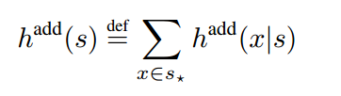
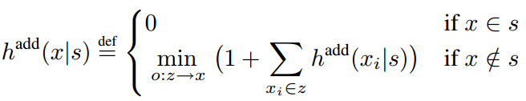
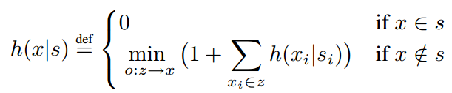
Introduction
Additive Heuristic（加法启发式）
x stands for the atoms v = d for v ∈ V and d ∈ Dv, and hadd(x|s) is an estimate of the cost of achieving x from s given as:

Slide 7
Introduction
Context-enhanced Additive Heuristic（上下文增强的加法启发式）
two questions: 1. how to choose the contexts si needed for evaluating the conditions xi in a given rule o : z → x 2. how to restrict the number of total contexts si needed for computing the heuristic value of s.
The answer to the first question implied by Helmert’s formulation is that for rules o : x0, z → x the condition x0 that refers to the same variable as x is achieved first, and the conditions in z are evaluated in the state s0 that results(Assumption 1)
The answer to the second question is that in the heuristic computation for a seed state s, the costs hcea(xi|si) for a context si are mapped into costs hcea(xi|s[x0 i]) where x0 i is the value of var(xi) in si, meaning that information in the state si about other variables is discarded (Assumption 2). We will write hcea(x|s[xi]) as hcea(x|xi).

Slide 8
Introduction
Relationship to Causal Graph Heuristic （与启发式因果图的关系）
Theorem 1 (hcea vs. hCG) If the causal graph CG(Π) is acyclic, then the causal graph heuristic hCG and the context-enhanced additive heuristic hcea are equivalent, i. e., for every state s, hCG(s) = hcea(s).
Relationship to Additive Heuristic （与加法启发式的关系）
Theorem 2 (hcea vs. hadd) In problems where all state variables have Boolean domains, the additive heuristic hadd and the context-enhanced additive heuristic hcea are equivalent, i. e., for every state s, hadd(s) = hcea(s).
the result suggests that the context-enhanced additive heuristic might be more informative than the additive heuristic: in the case of all-Boolean state variables, the two heuristics are the same, while in general, hcea may be able to use the context information to improve its estimates.

Slide 9
Introduction
Computing the Heuristic for Cyclic Graphs （计算循环图的启发式）
1.A critical :the cost of a node in the Dijkstra algorithm
2.By expanding nodes in order of increasing priority, rather than cost, we can compute hcea(s) much more efficiently.

Slide 10
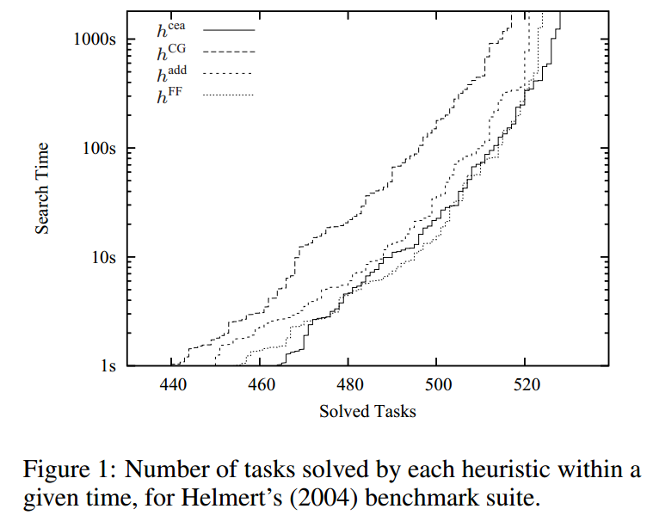
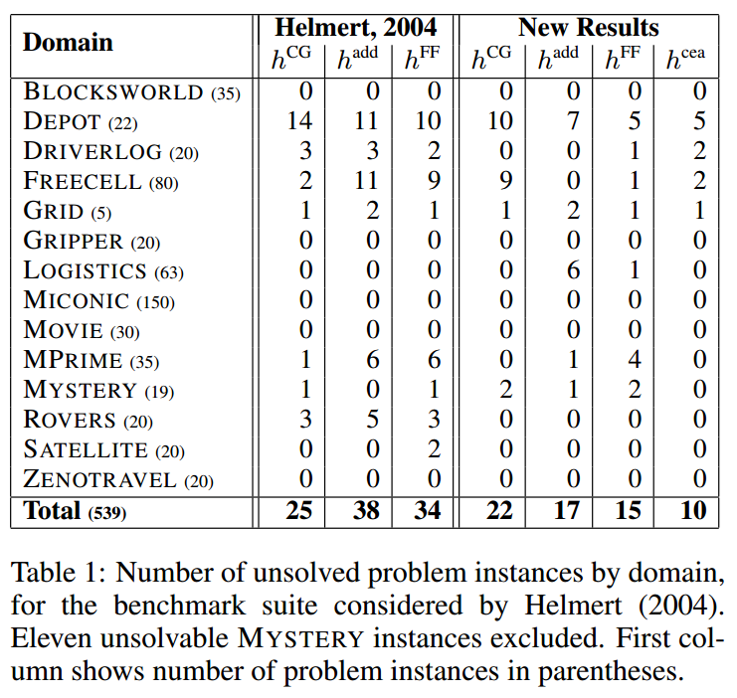
Experiments
First Experiment

Slide 11
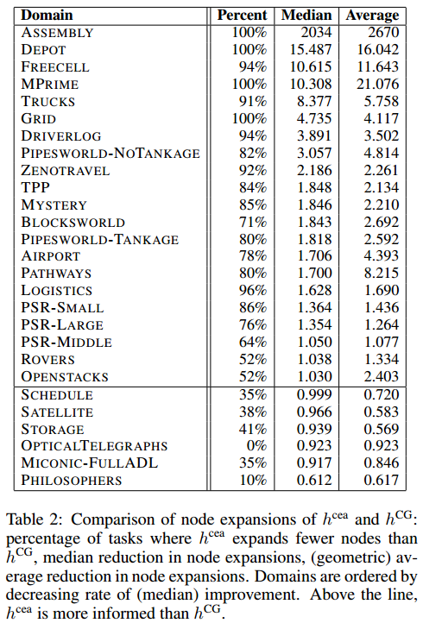
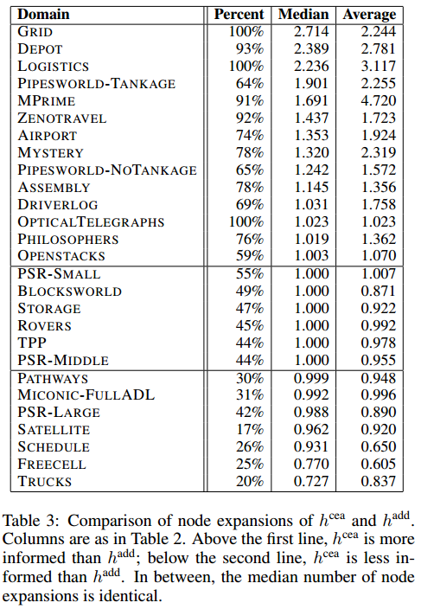
Experiments
Second Experiment

Slide 12
Discussion
The two assumptions
1.the contexts si for all the conditions xi in a rule o : x0, x1, . . . , xn → x are all the same and correspond to the state s0 resulting from achieving the first condition x0
2.h(xi|s0) is reduced to h(xi|s[x0 i]) where x0 i is the value of var(xi) in s0, thus effectively throwing away all the information in s0 that does not pertain to the variable associated with xi.

Slide 13
Generalizations
The formulation that follows from Assumptions 1 and 2 above presumes that in every rule z → x of the problem: a) there is a condition in the body of the rule that must be achieved first (we call it the pivot condition),
b) that this pivot condition involves the same variable as the head, and c) that no precedence information involving the rest of the conditions in z is available or usable.
Condition a) is not particularly restrictive as it is always possible to add a dummy pivot condition.
Condition b) restrictive, and often unnecessarily so.

Slide 14
Summary
1.context-enhanced additive heuristic, does not require acyclicity or causal graphs and leads to a natural generalization of both the causal graph and additive heuristics.
2.it establishes a strong connection between two previously unrelated research strands in heuristic search planning.
3.the context-enhanced additive heuristic also proves to be very strong in practice.
(1)all of which have to do with the use of ordering information among operator preconditions to capture side effects in the computation of the heuristic.
(2)There are some interesting connections with HTN planning, where precedence constraints among preconditions or subtasks are common

Slide 15
Thanks

